Slide 1
Features of Bitcoin
Bitcoin transactions

Slide 2
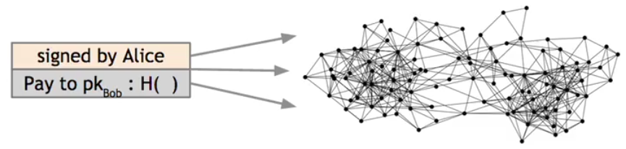
bitcoin_transaction example:
The transaction is going to have:
Alice's signature used by other nodes to check the orgin.
Bob's public key, which also accesses the address at which he wants to receive bitcoins
a hash of the previous transaction. This is a way for Alice to link this transaction to her receipt of this coin from someone else previously

Slide 3
An account-based ledger (not Bitcoin)
time
might need to scan backwards until genesis!
Create 25 coins and credit to Alice_{ASSERTED BY MINERS}
Transfer 17 coins from Alice to Bob_{SIGNED(Alice)}
Transfer 8 coins from Bob to Carol_{SIGNED(Bob)}
Transfer 5 coins from Carol to Alice_{SIGNED(Carol)}
is this valid?
Transfer 15 coins from Alice to David_{SIGNED(Alice)}
SIMPLIFICATION: only one transaction per block

Slide 4
Example
Inputs: Ø
Outputs: 25.0→Alice
1
time
we implement this with hash pointers
change address
Inputs: 1[0]
Outputs: 17.0→Bob, 8.0→Alice
SIGNED(Alice)
2
Inputs: 2[0]
Outputs: 8.0→Carol, 7.0→Bob
SIGNED(Bob)
finite scan to check for validity
3
Inputs: 2[1]
Outputs: 6.0→David, 2.0→Alice
SIGNED(Alice)
4
is this valid?
SIMPLIFICATION: only one transaction per block
Notes:
This is called a “change address”

Slide 5
Merging value
time
Inputs: ...
Outputs: 17.0→Bob, 8.0→Alice
SIGNED(Alice)
1
...
Inputs: 1[1]
Outputs: 6.0→Carol, 2.0→Bob
SIGNED(Carol)
2
...
Inputs: 1[0], 2[1]
Outputs: 19.0→Bob
SIGNED(Bob)
3
SIMPLIFICATION: only one transaction per block

Slide 6
Joint payments
time
Inputs: ...
Outputs: 17.0→Bob, 8.0→Alice
SIGNED(Alice)
1
...
Inputs: 1[1]
Outputs: 6.0→Carol, 2.0→Bob
SIGNED(Carol)
2
...
Inputs: 2[0], 2[1]
Outputs: 8.0→David
SIGNED(Carol), SIGNED(Bob)
3
two signatures!
SIMPLIFICATION: only one transaction per block

Slide 7
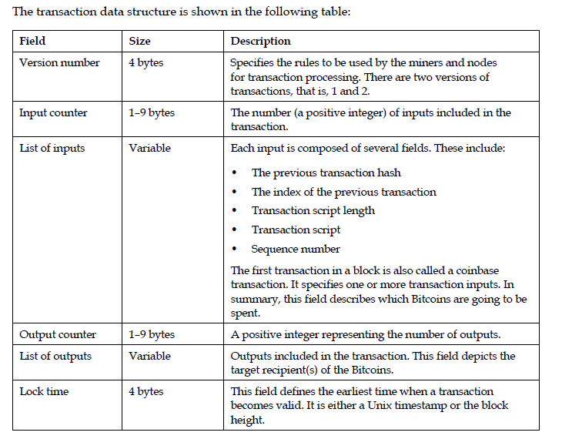
Transaction Data Structure

Slide 8
The real deal: a Bitcoin transaction
{ "hash":"5a42590fbe0a90ee8e8747244d6c84f0db1a3a24e8f1b95b10c9e050990b8b6b", "ver":1, "vin_sz":2, "vout_sz":1, "lock_time":0, "size":404, "in":[ { "prev_out":{ "hash":"3be4ac9728a0823cf5e2deb2e86fc0bd2aa503a91d307b42ba76117d79280260", "n":0 },
"scriptSig":"30440..." }, { "prev_out":{ "hash":"7508e6ab259b4df0fd5147bab0c949d81473db4518f81afc5c3f52f91ff6b34e", "n":0 }, "scriptSig":"3f3a4ce81...." } ], "out":[ { "value":"10.12287097", "scriptPubKey":"OP_DUP OP_HASH160 69e02e18b5705a05dd6b28ed517716c894b3d42e OP_EQUALVERIFY OP_CHECKSIG" } ]
}
metadata
input(s)
output(s)

Slide 9
The real deal: transaction metadata
{ "hash":"5a42590...b8b6b", "ver":1, "vin_sz":2, "vout_sz":1, "lock_time":0, "size":404,
...
}
transaction hash
housekeeping
“not valid before”
more on this later...
housekeeping

Slide 10
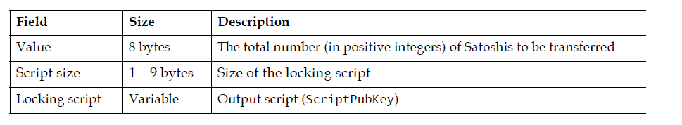
Transaction output data structure:

Slide 11
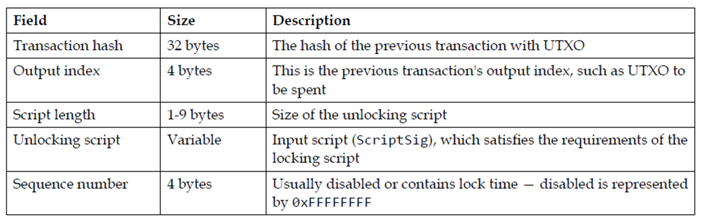
Transaction input data structure:

Slide 12
The real deal: transaction inputs
"in":[ { "prev_out":{ "hash":"3be4...80260", "n":0 },
"scriptSig":"30440....3f3a4ce81" }, ...
],
previous
transaction
signature
(more inputs)

Slide 13
Example to illustrate the concept of UTXO:
Let's say Alice has 10 bitcoins in her wallet, and she wants to send 2 bitcoins to Bob.
Initial State
Alice's wallet contains:
- UTXO1: 10 bitcoins (from a previous transaction)
Transaction
Alice creates a transaction to send 2 bitcoins to Bob:
- Input: UTXO1 (10 bitcoins)
- Output1: 2 bitcoins to Bob's address
- Output2: 8 bitcoins back to Alice's address (change)
New State
Alice's wallet contains:
- UTXO2: 8 bitcoins (change from the transaction)
Bob's wallet contains:
- UTXO3: 2 bitcoins (received from Alice)
In this example:
UTXO1 is spent and marked as spent
UTXO2 is created and available for Alice to spend
UTXO3 is created and available for Bob to spend

Slide 14
Input/Output “addresses” are really scripts
30440220...
0467d2c9...
scriptSig
OP_DUP
OP_HASH160
69e02e18...
OP_EQUALVERIFY OP_CHECKSIG
scriptPubKey
TO VERIFY: Concatenated script must execute completely with no errors

Slide 15

Bitcoin scripting language (“Script”)
Design goals
Built for Bitcoin (inspired by Forth)
Stack-based
non Turing complete
Reverse Polish Notation (RPN):
with two types of instructions
Support for cryptography
image via Jessie St. Amand

Slide 16
Bitcoin script instructions
256 opcodes total (15 disabled, 75 reserved)
Arithmetic
Logic/data handling
Crypto!
Hashes
Signature verification
Multi-signature verification

Slide 17
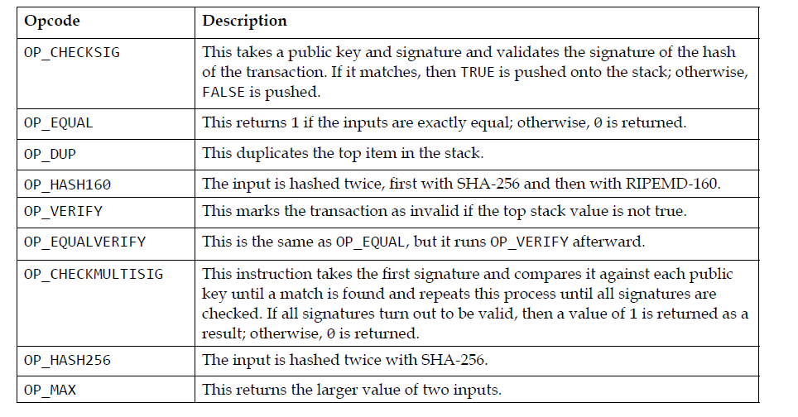
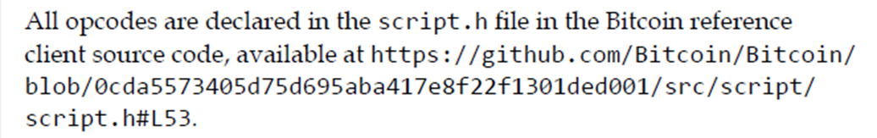
Commonly Used opcodes:

Slide 18
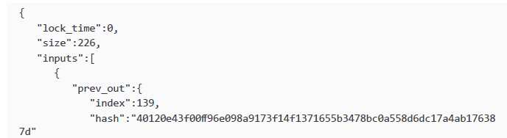
Sample transaction:
Note: Transactions with locktime specifying a future block or time must be held by the originating system and transmitted to the bitcoin network only after they become valid. The use of locktime is equivalent to postdating a paper check.

Slide 19
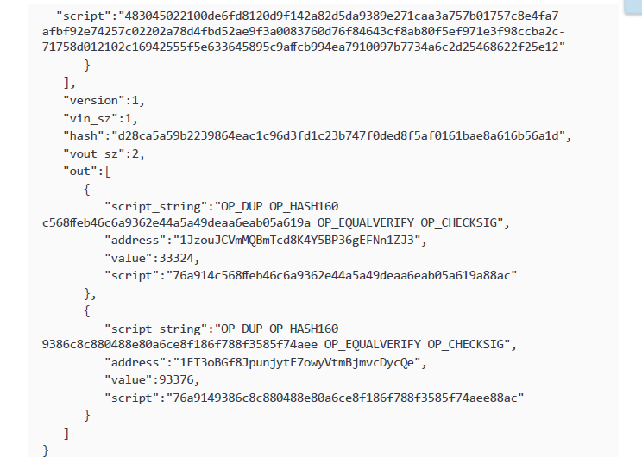
Continues;

Slide 20
Locking Script (ScriptPubKey)
Example: OP_DUP OP_HASH160 <pubKeyHash> OP_EQUALVERIFY OP_CHECKSIG
Unlocking Script (ScriptSig)
Example: <sig> <pubKey>
How it works
1.The locking script is stored in the UTXO and defines the conditions for spending the bitcoins.
2. The spender creates an unlocking script that satisfies the conditions of the locking script.
3. The unlocking script is combined with the locking script to create a valid transaction.
4. The transaction is verified by the network, and if valid, the bitcoins are spent.

Slide 21
The locking script defines the conditions for spending the bitcoins, and the unlocking script satisfies those conditions to unlock the bitcoins.

Slide 22
Types of standard Transaction scripts:
1. P2PKH (Pay-to-Public-Key-Hash) Script:
OP_DUP OP_HASH160 <pubKeyHash> OP_EQUALVERIFY OP_CHECKSIG
Example:
OP_DUP OP_HASH160 76a914b4736d6f2b3d6f6f6f6f6f6f6f6f6f6f6f6f OP_EQUALVERIFY OP_CHECKSIG
This script sends Bitcoins to a public key hash, requiring the recipient to provide the corresponding public key and signature to spend the funds
1. Public Key Hash: The sender generates a public key hash (address) from the recipient's public key using a one-way cryptographic function (RIPEMD-160 and SHA-256).
2. Script Creation: The sender creates a P2PKH script, which includes:
- OP_DUP (duplicate top stack element)
- OP_HASH160 (hash top stack element with RIPEMD-160 and SHA-256)
- Public Key Hash (address)
- OP_EQUALVERIFY (check if top two stack elements are equal)
- OP_CHECKSIG (verify signature)
3. Transaction: The sender creates a transaction with the P2PKH script and signs it with their private key.
4. Verification: The network verifies the transaction by:
- Hashing the recipient's public key to match the public key hash (address)
- Checking the signature with the recipient's public key

Slide 23
2.P2SH (Pay-to-Script-Hash) Script:
OP_HASH160 <scriptHash> OP_EQUAL
Example:
OP_HASH160 51b7b5e8f6f6f6f6f6f6f6f6f6f6f6f6f OP_EQUAL
This script sends Bitcoins to a script hash, requiring the recipient to provide the corresponding script and inputs to spend the funds.
1. Script Creation: The sender creates a P2SH script, which includes:
- Redeem script (contains the actual spending conditions)
- OP_HASH160 (hash redeem script with RIPEMD-160 and SHA-256)
- Script Hash (address)
2. Transaction: The sender creates a transaction with the P2SH script and signs it with their private key.
3. Verification: The network verifies the transaction by:
- Hashing the redeem script to match the script hash (address)
- Executing the redeem script to check spending conditions

Slide 24
Key differences
- Address type: P2PKH uses a public key hash (address), while P2SH uses a script hash (address).
- Script complexity: P2PKH has a fixed, simple script, while P2SH allows for more complex scripts and smart contracts.
- Verification: P2PKH verifies a signature, while P2SH executes a redeem script to check spending conditions.
Example
Suppose Alice wants to send 1 BTC to Bob's multi-signature wallet, requiring 2-of-3 signatures from Bob, Charlie, and David.
- P2PKH: Alice sends 1 BTC to Bob's public key hash (address). Bob can spend the funds alone.
- P2SH: Alice sends 1 BTC to a script hash (address) containing the multi-signature redeem script. The script requires 2 signatures from Bob, Charlie, and David to spend the funds.

Slide 25
3. Multisig Script:
OP_2 <pubKey1> <pubKey2> OP_2 OP_CHECKMULTISIG
Example:
OP_2 03f3f3f3f3f3f3f3f3f3f3f3f3f3f3f3f 03f4f4f4f4f4f4f4f4f4f4f4f4f4f4f4 OP_2 OP_CHECKMULTISIG
This script requires multiple signatures (in this case, 2) to spend the funds.
4. Null data/OP-RETURN Script:
OP_RETURN <data>
Example:
OP_RETURN 6a146f6f6f6f6f6f6f6f6f6f6f6f6f6f
This script stores arbitrary data on the blockchain, marking the transaction as invalid.

Slide 26
Bitcoin script execution example
✓
<pubKeyHash?>
<pubKey>
<pubKeyHash>
<pubKey>
<sig>
true
<sig> <pubKey> OP_DUP OP_HASH160 <pubKeyHash?> OP_EQUALVERIFY OP_CHECKSIG

Slide 27
Applications of Bitcoin Scripts

Slide 28
Some are
1. Escrow transactions
2 . Green addresses
3. Efficient micro-payments

Slide 29

Example 1:Escrow transactions
(disputed case)
(normal case)
Pay x to Bob
SIGNED(ALICE, BOB)
Pay x to Alice
SIGNED(ALICE, JUDY)
Judy
To: Alice
From: Bob
PROBLEM: Alice wants to buy online from Bob. Alice doesn’t want to pay until after Bob ships.
Bob doesn’t want to ship until after Alice pays.
Alice
Pay x to 2-of-3 of Alice, Bob, Judy (MULTISIG)
SIGNED(ALICE)
Bob
Notes:
Gavel from OpenClipArt.com

Slide 30
\Example:
OP_2 <Alice's pubkey> <Bob's pubkey> <Escrow Agent's pubkey> OP_3 OP_CHECKMULTISIG

Slide 31
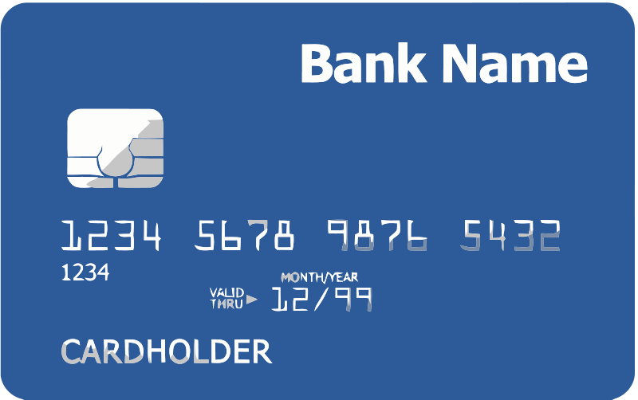

Example 2 : Green addresses
004 days since last double spend!
It’s me, Alice! Could you make out a green payment to Bob?
Faraday cage
Bank
Pay x to Bob, y to Bank
SIGNED(BANK)
No double spend
Alice
Bob
Notes:
These are mostly dead thanks to Mt. Gox, Instawallet

Slide 32
Example 3: Efficient micro-payments
What if Bob never signs??
Input: x; Pay 42 to Bob, 58 to Alice
SIGNED(ALICE) SIGNED(BOB)
all of these could be double-spends!
Input: x; Pay 42 to Bob, 58 to Alice
SIGNED(ALICE)___________
With this feature Alice knows that she can get her money back if Bob never signs the transactions.
...
Alice demands a timed refund transaction before starting
Input: x; Pay 04 to Bob, 96 to Alice
SIGNED(ALICE)___________
Input: x; Pay 100 to Alice, LOCK until time t
SIGNED(ALICE) SIGNED(BOB)
I’m done!
I’ll publish!
Input: x; Pay 03 to Bob, 97 to Alice
SIGNED(ALICE)___________
Input: x; Pay 02 to Bob, 98 to Alice
SIGNED(ALICE)___________
Input: x; Pay 01 to Bob, 99 to Alice
SIGNED(ALICE)___________
PROBLEM: Alice wants to pay Bob for each minute of phone service. She doesn’t want to incur a transaction fee every minute.
Bob
Alice
Input: y; Pay 100 to Bob/Alice (MULTISIG)
SIGNED(ALICE)
Notes:
What if Bob never paid?

Slide 33
Other applications
There are many other possible applications of Bitcoin protocol, more complicated that the one explained, for example:
multi-player lotteries, that requires a very complicated, multi-step protocol
people can get their coins together and mix them so that it's harder to trace who owns which coins and provides a higher level of anonimity
a huge variety of smart contract, even if there are a lot of limitations in this field, since some operations are not permitted by Bitcoin scripting language, or because nobody has figured out yet how to manage them with Bitcoin system.

Slide 34
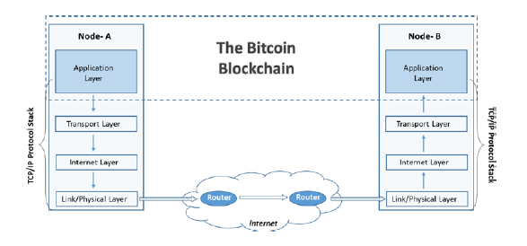
Bitcoin Network:

Slide 35
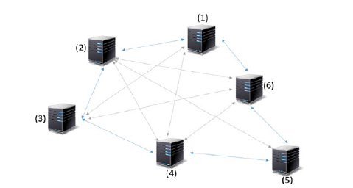
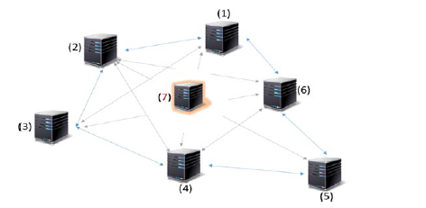
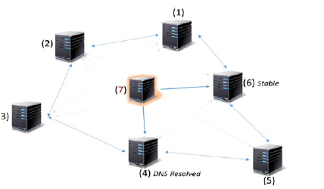
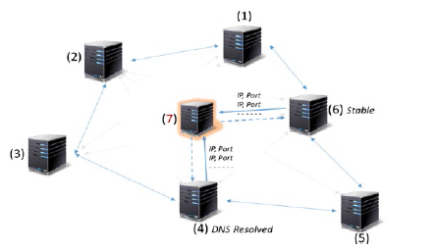
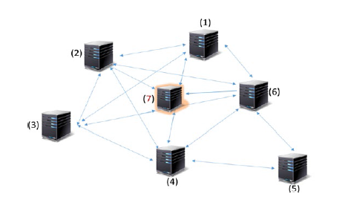
Netwrok discovery for a new node:

Slide 36
Full nodes, Lightweight nodes
Limitations and Improvements of Bitcoin protocol

Slide 37
Proof-of-Work Properties
The proof-of-work function of an hash puzzle must be:
1.Difficult to compute
2. The difficulty is parameterizable
3. It’s trivial to verify the new node has computed proof-of-work correctly

Slide 38
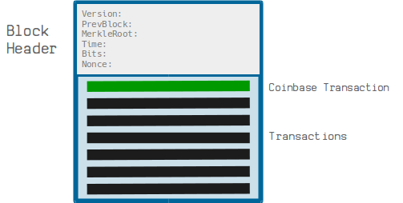
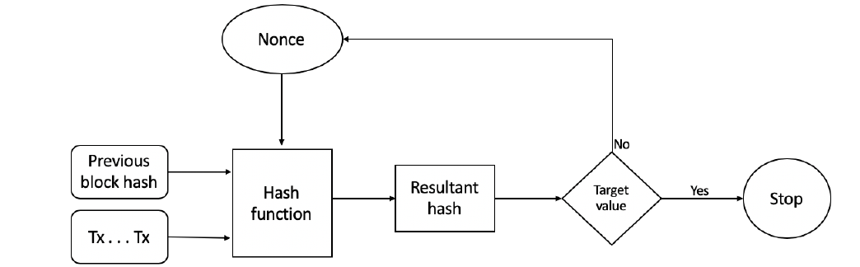
Proof-of-work (POW) :

Slide 39
Proof-of-work :
POW works as follows:
POW makes use of hash puzzles
A node proposes a block has to find a nonce such that H(nonce || previous hash || Tx || Tx|| …..|| Tx ) < Target value
The process can be summarized as:
New transactions are broadcast to all nodes on the network
Each node collects the transactions into a candidate block
Miners propose new blocks
Miners concatenate and hash with the header of the previous block
The resultant has is checked against the target value (network difficulty target value)
If the resultant hash is less than the target value then POW is solved. Otherwise the nonce is incremented and the node tries again. This process continues until a resultant hash is found that is less than target value.

